Slide 1
We Need to learn Spanish- WHY???
6th Grade introductory Spanish Project

Slide 2
This project is intended for an introductory unit in Spanish at the 6th grade level. Students need to buy-in
to the importance of learning Spanish in order to engage completely.
Students will be working on a PBL experience to appreciate and understand the need for learning Spanish.
As adults, many of us wish we could speak the second most commonly used language in our country,
yet 11-year-old students may not be aware of the importance.
Students will be researching to discover ways learning Spanish may give them an advantage personally
(getting into college, finding a good job, and earning more money),how it may help others that they
encounter in their community, and how it will improve their brain function.
They will find out about the millions of people throughout the world who speak primarily Spanish,
and the 20 countries where Spanish is the official language.
Using the PBL experience, students will actively discover the information that I usually give to them
through note-taking and class discussion. With this method students will be much more engaged
and will be compelled to create, as their culminating product, a video advertisement depicting why
they will study Spanish for at least the next three years. (And hopefully throughout their lives!)

Slide 3
Launch: short video with minion chatter. Did you understand them?
This Photo by Unknown Author is licensed under CC BY-NC-ND

Slide 4
Count down to Open House!
10 days…
Students will prepare a persuasive
video via Imovie, or Animoto to be
presented at the Open House.
This Photo by Unknown Author is licensed under CC BY-NC
This Photo by Unknown Author is licensed under CC BY

Slide 5
Ways students will make their discoveries:
Reading related articles online about benefits of learning another language
Interviewing a member of the community whose first language is Spanish
Discussing their own ideas
Viewing a TED talk about how languages affect the brain
Reading articles about how learning a second language helps cognition
Reading related articles about where Spanish is the official language
This Photo by Unknown Author is licensed under CC BY-SA

Slide 6
Assessments that will help sustain interest and motivation throughout the project :
Journal/notes (outlining and responding to articles and videos)
Pizza Consensus (relating preconceived ideas about foreign language)
Stand and Deliver (from articles)
Gallery Walk (using story boards about how their videos will be set up)

Slide 7
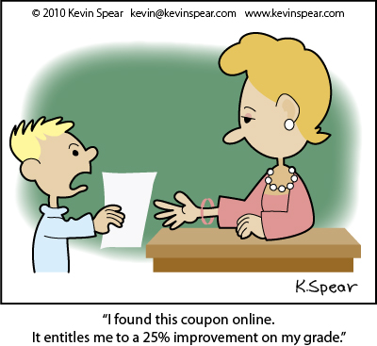
How the project will impact my students:
This activity gives students the opportunity to make discoveries about where Spanish is spoken and how important it is for us to learn. They will get to choose a reason they feel is most important to them and illustrate their findings by creating a video. Throughout the year, if they lose motivation, we can view the videos as reminders.

